Slide 1

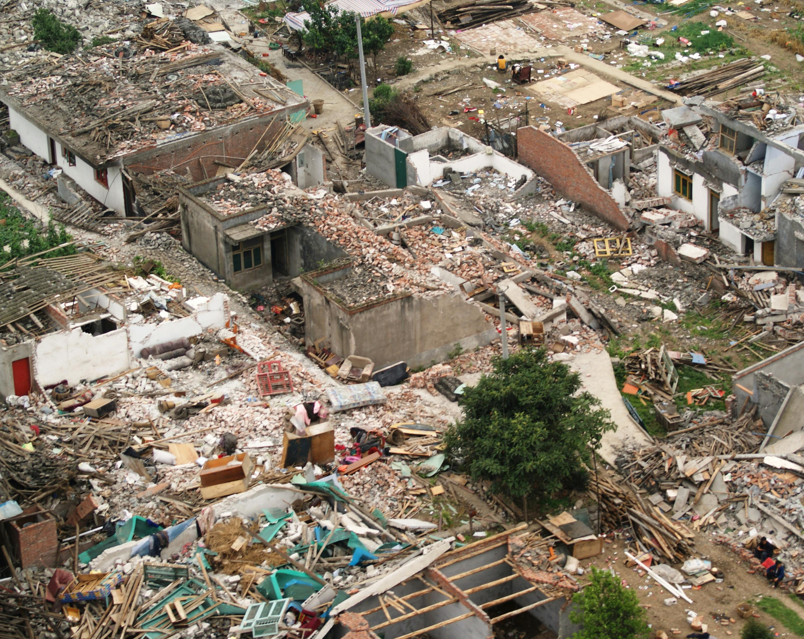
Earthquake Forecasting Using Machine Learning Algorithm Dissertation Project Presentation
Ghanshyam Kumar Mahato
York St John University
August 2024

Slide 2


Introduction
Ghanshyam Kumar Mahato.
Pursuing: MSc Computer Science, York St. John University, London, united kingdom
B-Tech computer science, Tula’s Institute, Dehradun, India (2020)
Homeland: Nepal
Dissertation Topic: Earthquake Forecasting Using Machine Learning Algorithms
Significance: Potential to provide early warnings and mitigate earthquake impacts
Enhances understanding of earthquake occurrences
Contributes to machine learning applications in environmental science
Objectives:
Explore the potential of using machine learning for earthquake forecasting
Identify patterns and correlations to predict seismic events
Develop a robust forecasting model for early warning systems and disaster preparedness
This Photo by Unknown Author is licensed under CC BY-SA

Slide 3

Background/Purpose
Importance of Earthquake Forecasting and Its Impact on Society
Earthquake forecasting is crucial for disaster preparedness and mitigation.
Early warnings can save lives, reduce injuries, and minimize property damage.
Helps in planning and implementing evacuation procedures and safety measures.
The Motivation Behind Choosing This Research Topic
Personal interest in leveraging technology for solving real-world problems.
Inspired by the devastating impacts of earthquakes globally.
Aim to contribute to scientific knowledge and practical applications in disaster management.
Hypotheses
Hypothesis 1:The varying distance between the Earth and the Moon affects earthquake occurrences.
Hypothesis 2:Non-uniform gravity on Earth's surface has a relationship with seismic events.

Slide 4

Methodology
Data Collection:
Seismic databases(USGS),
Historical earthquake catalogs
Web scraping
Types of Data Collected:
Magnitude, location, depth, date, and time of earthquakes
Distance between Earth and Moon
Gravitational forces between Earth and Moon
Ununiform gravity on earth surface
Data Preprocessing:
Handling missing values and outliers
Feature Engineering and Selection:
Using ANOVA and other statistical tests
Model Selection:
Based on the nature of the dependent variable (regression, SVM, RFR, GBR, ANN)
Pipeline Creation and Parameter Tuning:
Splitting data into training and testing sets
Creating pipelines
Tuning parameters for optimal performance

Slide 5
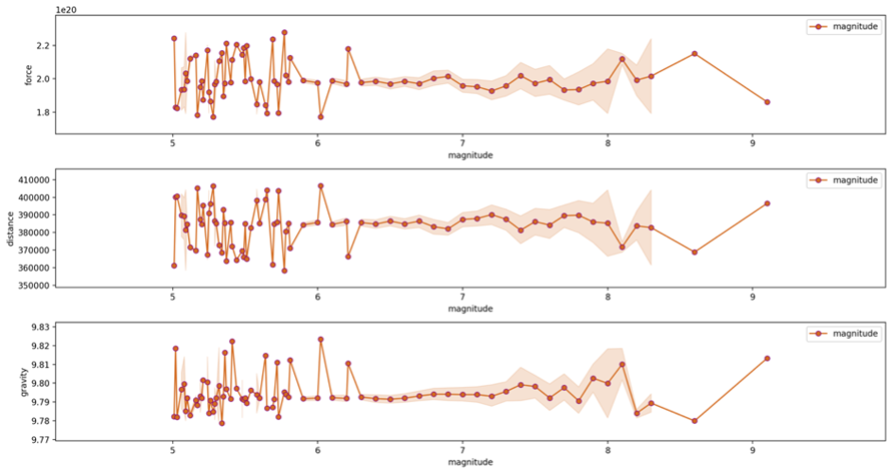
Findings/Results
Key Findings from Data Analysis and Model Predictions:
Identified significant patterns and correlations between seismic activities and gravitational forces.
Developed a predictive model that shows promising accuracy in forecasting earthquake occurrences.
Dataset | MSE | MAE | R²
70 training - 30 testing | 0.126 | 0.235 | 0.299
80 training - 20 testing | 0.126 | 0.245 | 0.299
90 training - 10 testing | 0.126 | 0.235 | 0.299

Slide 6

Discussion
The model explained approximately 29.91% variance in the dependent variable.
Moderate explanatory power with low prediction error (MSE 0.126, MAE 0.2369).
Gravitational force, Earth-Moon distance, and gravity at earthquake epicenters provided valuable insights.
Highlighted the importance of integrating geophysical and astronomical variables.

Slide 7
Conclusion
Summary of the Research Objectives, Methodology, and Key Findings:
Objectives:
Investigate the potential of using machine learning for earthquake forecasting.
Examine the impact of gravitational forces and Earth-Moon distance on seismic events.
Methodology:
Data collection from seismic databases, historical earthquake catalogs, and web scraping.
Data preprocessing, feature selection using Information Gain, ANOVA, and Lasso.
Model development using Random Forest Regressor.
Key Findings:
The Random Forest Regressor achieved an R² score of approximately 0.299 with an MSE of 0.126 and MAE of 0.2369.
Significant correlations found between seismic activities and features like gravitational force, Earth-Moon distance, and localized gravity variations.
Conclusions Drawn from the Study:
The integration of geophysical and astronomical variables enhances earthquake prediction models.
The Random Forest Regressor showed moderate explanatory power, indicating its reliability in predicting earthquake magnitudes.
The relatively low R² value suggests additional factors and complexities not captured by the current model.
Dataset | MSE | MAE | R²
70 training - 30 testing | 0.126 | 0.235 | 0.299
80 training - 20 testing | 0.126 | 0.245 | 0.299
90 training - 10 testing | 0.126 | 0.235 | 0.299

Slide 8
Recommendations for Future Research:
The integration of geophysical and astronomical variables enhances earthquake prediction models.
The Random Forest Regressor showed moderate explanatory power, indicating its reliability in predicting earthquake magnitudes.
The relatively low R² value suggests additional factors and complexities not captured by the current model.

Slide 9


Reference List
Abrahamson, N.A. and Litehiser, J.J. (1989) 'Attenuation of vertical peak acceleration', Bulletin of the Seismological Society of America, 79(3), pp. 549-580.
Agrawal, D.C. (2015) 'Micro moon versus macro moon: Brightness and size', arXiv Preprint arXiv:1507.03578, .
Alexandridis, A., Chondrodima, E., Efthimiou, E., Papadakis, G., Vallianatos, F. and Triantis, D. (2013) 'Large earthquake occurrence estimation based on radial basis function neural networks', IEEE Transactions on Geoscience and Remote Sensing, 52(9), pp. 5443-5453.
Alves, E.I. (2006) 'Earthquake forecasting using neural networks: Results and future work', Nonlinear Dynamics, 44, pp. 341-349.
Debnath, P., Chittora, P., Chakrabarti, T., Chakrabarti, P., Leonowicz, Z., Jasinski, M., Gono, R. and Jasińska, E. (2021a) 'Analysis of earthquake forecasting in india using supervised machine learning classifiers', Sustainability, 13(2), pp. 971.
Debnath, P., Chittora, P., Chakrabarti, T., Chakrabarti, P., Leonowicz, Z., Jasinski, M., Gono, R. and Jasińska, E. (2021b) 'Analysis of earthquake forecasting in india using supervised machine learning classifiers', Sustainability, 13(2), pp. 971.
Emeç, M. and Özcanhan, M.H. (2024) 'Application of artificial neural network methods to anatolian plate earthquake magnitude and location prediction', Journal of Engineering Technology and Applied Sciences, 9(2), pp. 47-62.
Galkina, A. and Grafeeva, N. (2019) 'Machine learning methods for earthquake prediction: A survey', Proceedings of the fourth conference on software engineering and information management (SEIM-2019), Saint Petersburg, Russia.pp. 25.
Geller, R.J. (1997) 'Earthquake prediction: A critical review', Geophysical Journal International, 131(3), pp. 425-450.
Hagen, M. and Azevedo, A. (2017) 'Sun-moon-earth interactions, external factors for earthquakes', Natural Science, 9(6), pp. 162-180.
Höber, D., Taschner, A. and Fimbinger, E. (2021) 'Excavation and conveying technologies for space applications', Berg Huettenmaenn.Mon, 166, pp. 95-103.
Joshi, A., Raman, B., Mohan, C.K. and Cenkeramaddi, L.R. (2024) 'Application of a new machine learning model to improve earthquake ground motion predictions', Natural Hazards, 120(1), pp. 729-753.
Kulkarni, E.G. and Kulkarni, R.B. (2016) 'Weka powerful tool in data mining', International Journal of Computer Applications, 975, pp. 8887.
Mahmud, S. (2019) 'The combined effects of the gravitational forces on the tectonic plates on earth‟ s surface exerted by the moon, the sun and the other planets are one of the main reasons of the earthquakes', Int.J.Adv.Res.Phys.Sci, 6, pp. 44-62.
Mölg, T. and Kaser, G. (2021) 'Springer textbooks in earth sciences, geography and environment. 483–495', .
Peng, C.J., Lee, K.L. and Ingersoll, G.M. (2002) 'An introduction to logistic regression analysis and reporting', The Journal of Educational Research, 96(1), pp. 3-14. Available at: https://doi.org/10.1080/00220670209598786 .
Rösch, J. (1972) 'Laser measurements of earth-moon distances', The Moon, 3(4), pp. 448-455.
Rosenfeld, L. (1965) 'Newton and the law of gravitation', Archive for History of Exact Sciences, 2(5), pp. 365-386.
Salam, M.A., Ibrahim, L. and Abdelminaam, D.S. (2021) 'Earthquake prediction using hybrid machine learning techniques', International Journal of Advanced Computer Science and Applications, 12(5), pp. 654-6652021.
Si, H. and Midorikawa, S. (2000) 'New attenuation relations for peak ground acceleration and velocity considering effects of fault type and site condition', Proceedings of 12th World Conference on Earthquake Engineering.
Straser, V. (2010) 'Variations in gravitational field, tidal force, electromagnetic waves and earthquakes', New Concepts in Global Tectonics Newsletter, 57(2010), pp. 98-108.
Tan, O., Tapirdamaz, M.C. and Yörük, A. (2008) 'The earthquake catalogues for turkey', Turkish Journal of Earth Sciences, 17(2), pp. 405-418.
Yu, Y., Si, X., Hu, C. and Zhang, J. (2019) 'A review of recurrent neural networks: LSTM cells and network architectures', Neural Computation, 31(7), pp. 1235-1270.
Zechar, J.D. and Nadeau, R.M. (2012) 'Predictability of repeating earthquakes near parkfield, california', Geophysical Journal International, 190(1), pp. 457-462.

